Slide 1



DIGTITAL PORTFOLIO
Name:
V.NARENDHIRAN
Register No:
2428A0024
NMid:
ASBRU262428A0024
Department:
B.SC.DIGITAL AND CYBER FORENSIC SCIENCE
College:
SHRI NEHRU MAHA VIDHLAYA COLLEGE OF ARTS AND SCIENCE
1

Slide 2

project title
PERSONAL PORTFOLIO WEBSITE
2

Slide 3

AGENDA
1.Problem Statement
2.Project Overview
3.End Users
4.Tools and Technologies
5.Portfolio design and Layout
6.Features and Functionality
7.Results and Screenshots
8.Conclusion
9.Github Link
3

Slide 4


PROBLEM STATEMENT
4

Slide 5

PROJECT OVERVIEW
We build website that empowers organizations to effectively integrate their data, decisions, and operations.
5

Slide 6




WHO ARE THE END USERS?
6

Slide 7
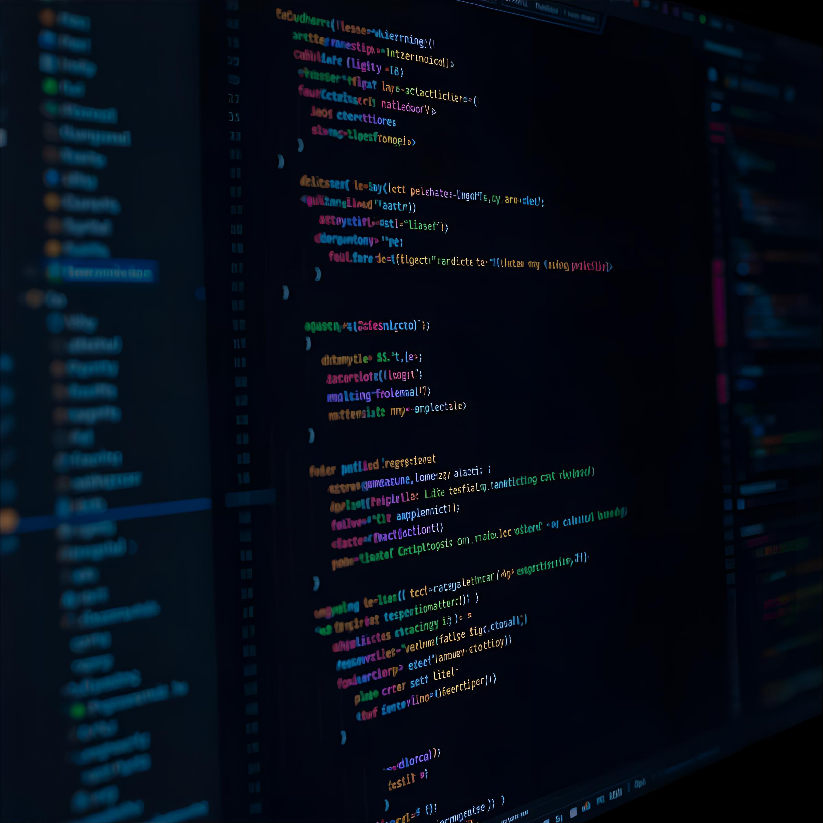
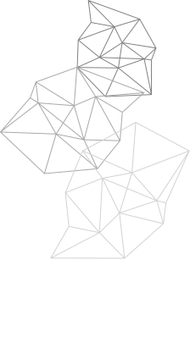
TOOLS AND TECHNIQUES
7

Slide 8
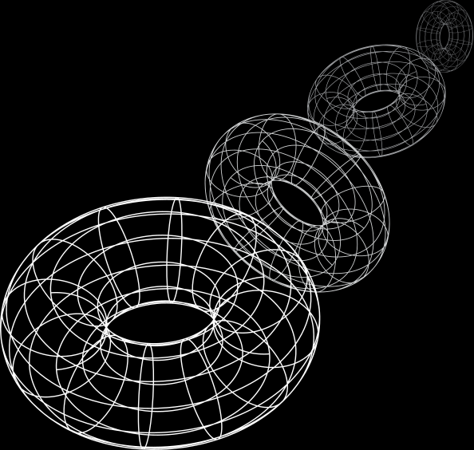
POTFOLIO DESIGN AND LAYOUT
A presentation is a formal or informal communication method that involves conveying information, ideas, or a message to an audience. It often employs visual aids such as slides, charts, graphs, or multimedia elements to support and enhance the spoken content.
8

Slide 9
FEATURES AND FUNCTIONALITY
Q1
Q2
Q3
Idea Generation
Market Research
Concept
Brand Survey
Brand Awareness & Marketing
Component Research
Cost Analysis
Testing functions
Apps interaction
Product Handling
Launch
9

Slide 10
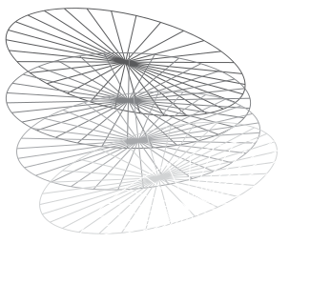
RESULTS AND SCREENSHOTS
10

Slide 11

CONCLUSION
11

Slide 12
THANK YOU
12

